Slide 1

Introduction to PROLOG
Dr. Norshuhani Zamin

Slide 2
PROLOG
Prolog stands for PROGramming in LOGic. In the logic programming paradigm, prolog language is most widely available. Prolog is a declarative language, which means that a program consists of data based on the facts and rules (Logical relationship) rather than computing how to find a solution.
A logical relationship describes the relationships which hold for the given application.
To obtain the solution, the user asks a question rather than running a program. When a user asks a question, then to determine the answer, the run time system searches through the database of facts and rules.

Slide 3
Applications of PROLOG
The applications of prolog are as follows:
Specification Language
Robot Planning
Natural language understanding
Machine Learning
Problem Solving
Intelligent Database retrieval
Expert System
Automated Reasoning

Slide 4
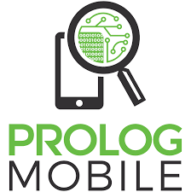
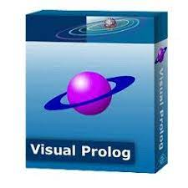



PROLOG Software Tools

Slide 5
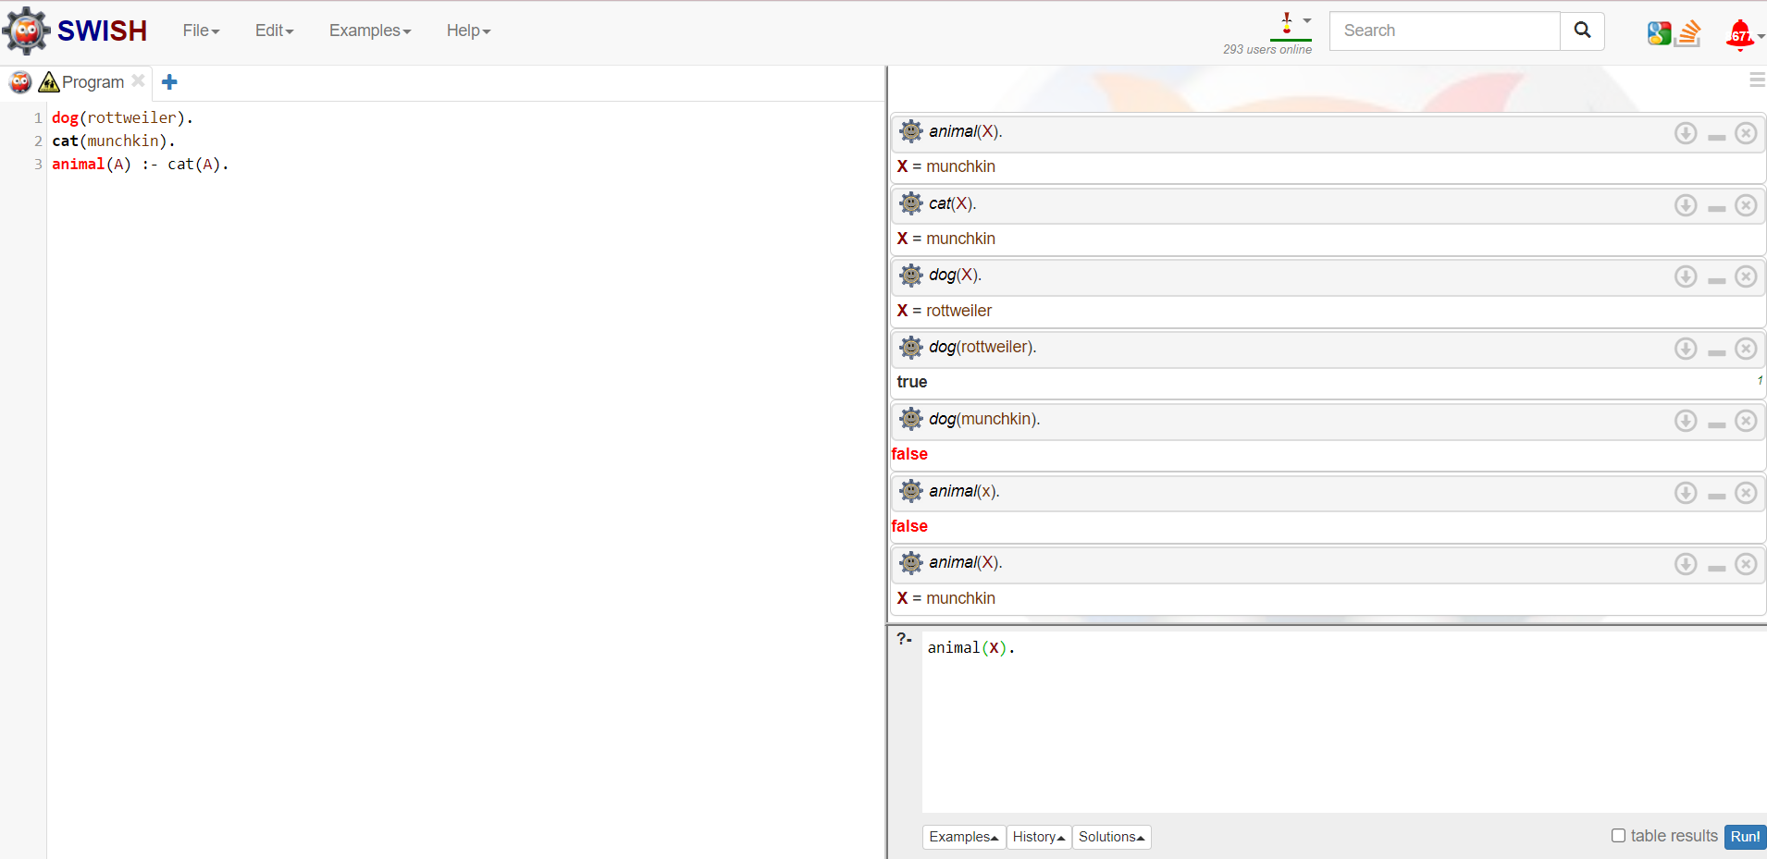
PROLOG Online Editor

Slide 6
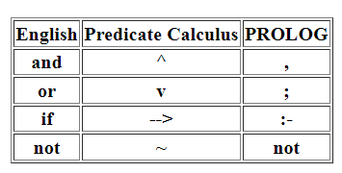
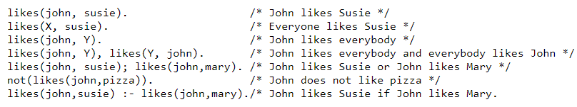
PROLOG Syntax
Symbols:
Variables and constants:
Variables begin with an uppercase letter. Predicate names, function names, and the names for objects must begin with a lowercase letter.
Facts:
A fact is a predicate expression that makes a declarative statement about the problem domain. Whenever a variable occurs in a Prolog expression, it is assumed to be universally quantified. Note that all Prolog sentences must end with a period (.)
Rules:
A rule is a predicate expression that uses logical implication (:-) to describe a relationship among facts. Thus a Prolog rule takes the form:
The left_hand_side is restricted to a single, positive, literal, which means it must consist of a positive atomic expression. It cannot be negated and it cannot contain logical connectives.

Slide 7
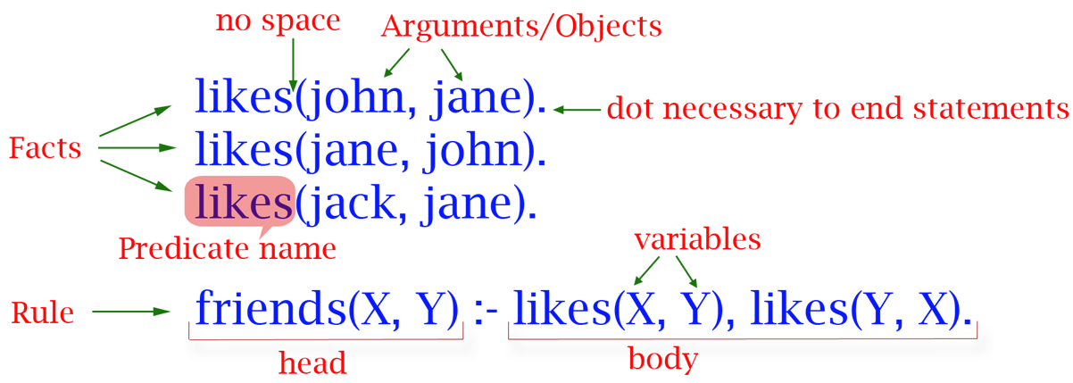
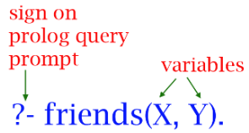

PROLOG Syntax
NOTE:
Variables must be in upper case
Constant must be in lower case

Slide 8


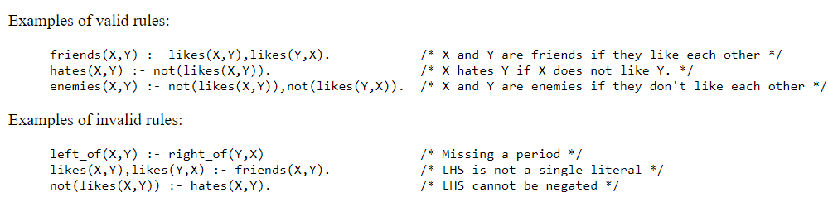
PROLOG Syntax
Facts:
Rules:
Query:
?- animal(rottweiler). True
?- animal(munchkin). False
This mean if A is a dog then A is an animal

Slide 9
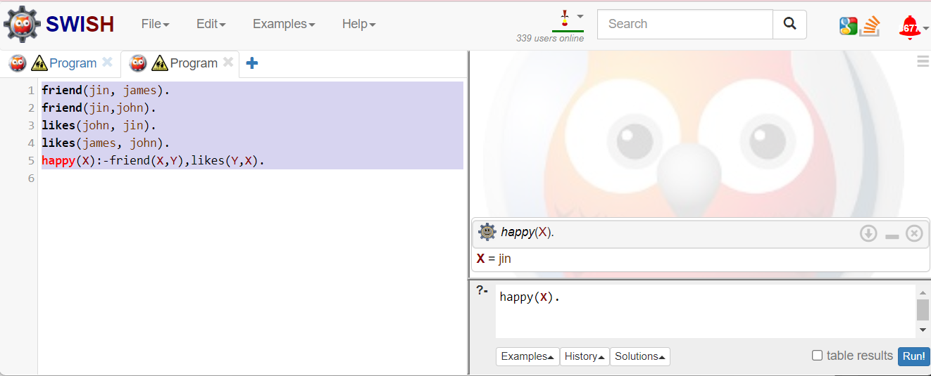
PROLOG Example 1:
Program : friend(jin, james). friend(jin,john). likes(john, jin). likes(james, john). happy(X):-friend(X,Y),likes(Y,X). Question: Who is happy?

Slide 10
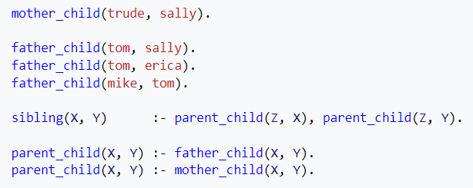


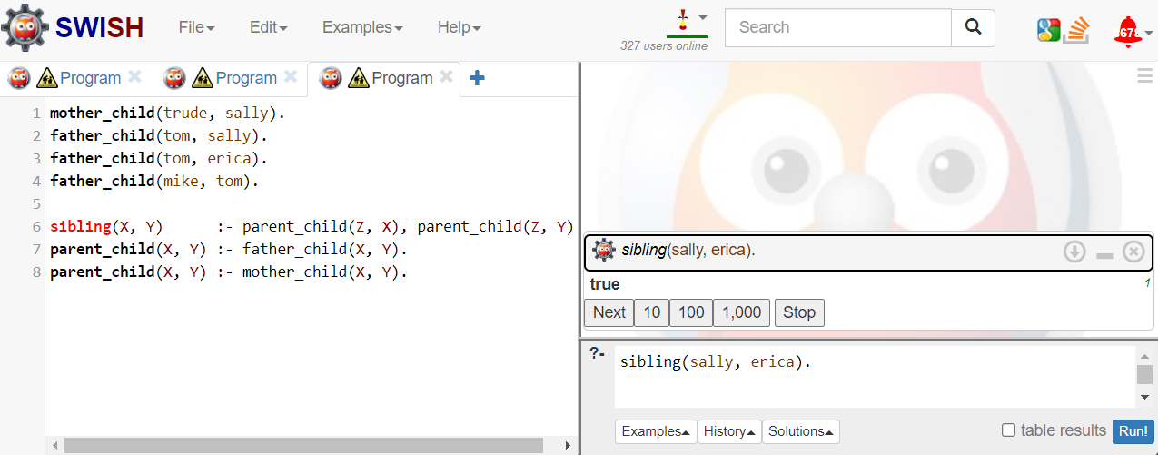
PROLOG Example 2:
Program :
Find:

Slide 11
Exercise 1:
For given English statements write a prolog program. Facts & Rules: (1) jia is a woman. (2) john is a man. (3) john is healthy. (4) jia is healthy. (5) john is wealthy. (6) anyone is a traveler if he is healthy and wealthy. (7) anyone can travel if he is a traveler. Queries: (1) Who can travel? (2) Who is healthy and wealthy?

Slide 12
Exercise 2:
What answers do you get for below queries for given program. Facts & Rules: vegetarian(jose). vegetarian(james). vegetable(carrot). vegetable(egg_plant). likes(jose, X) :- vegetable(X). loves(X, egg_plant) :- vegetarian(X). Queries: ?- vegetable(X). ?- vegetable(potato). ?- vegetarian(Y). ?- likes(jose, X). ?- likes(Y, egg_plant). ?- loves(Z, egg_plant).

